Slide 1
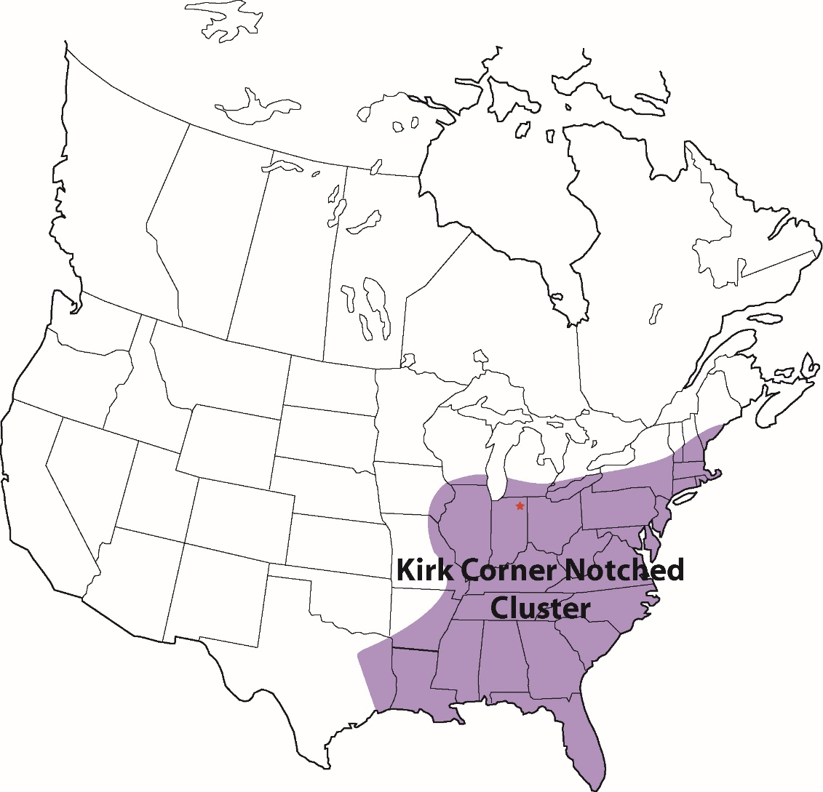
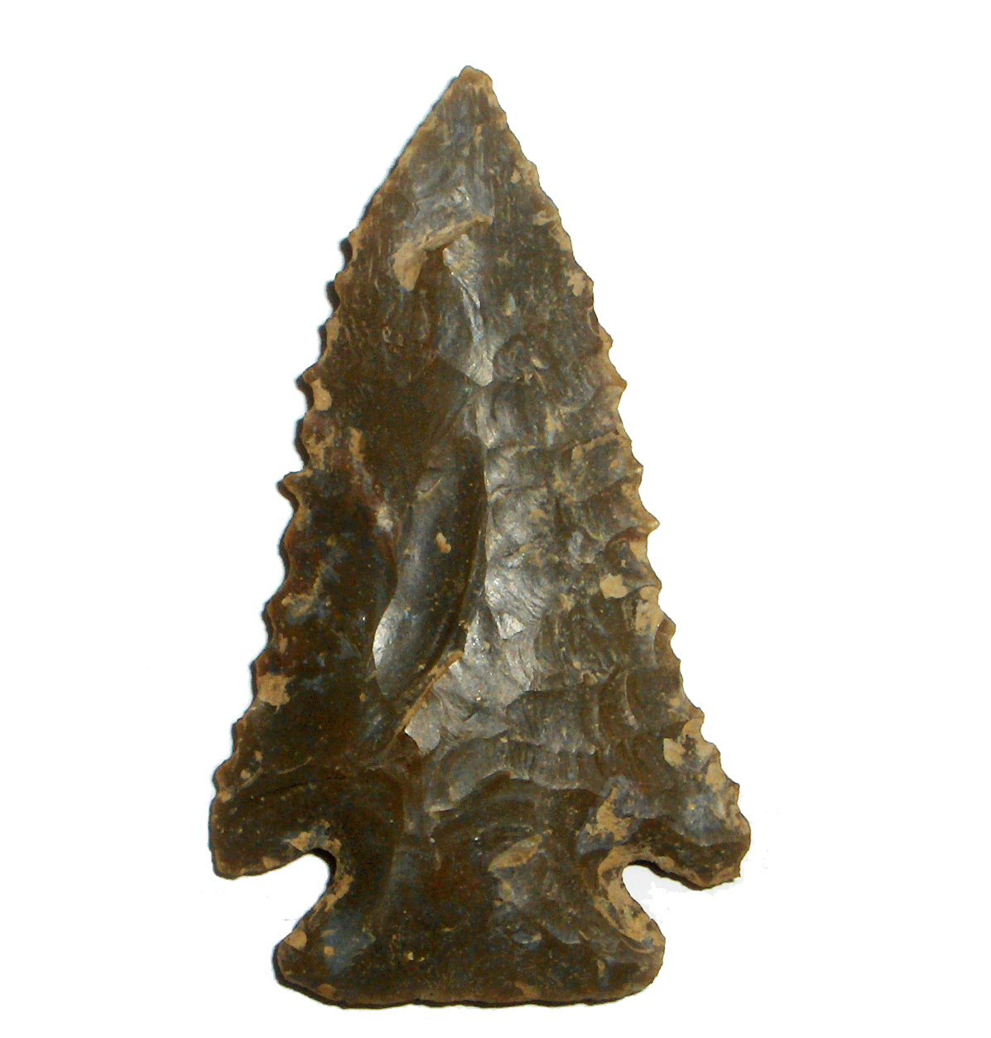
The Kirk Project and the Early Archaic of South Carolina
Andrew A. White
February 20, 2016
aawhite@mailbox.sc.edu

Slide 2
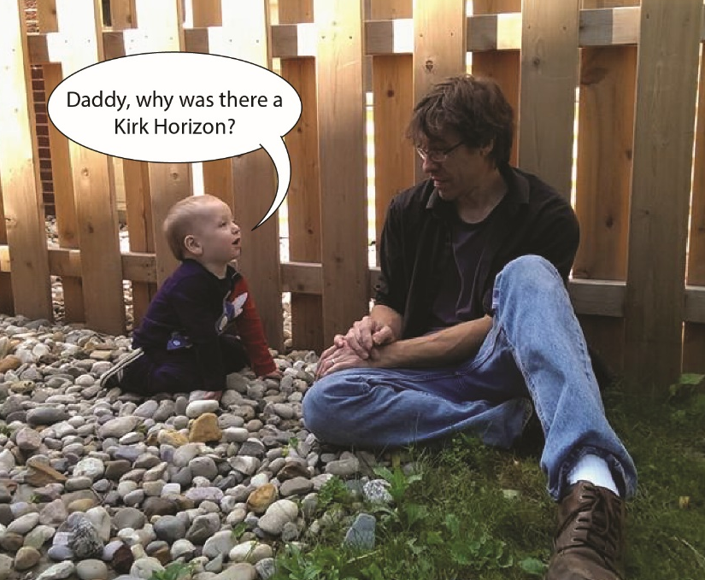
A fair question that’s been around for over forty years now

Slide 3
The “Kirk Horizon” (~11,000-10,000 Calendar YBP)
Distribution of Kirk Corner Notched cluster (following Justice 1987)

Slide 4
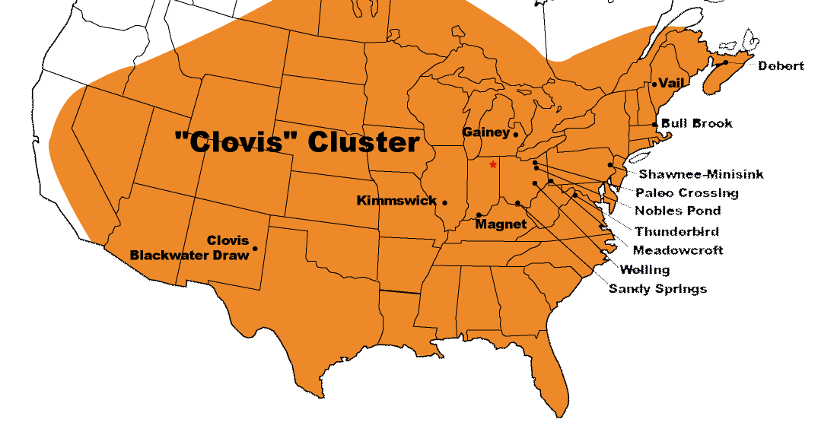
“Kirk Horizon” associated with (apparently) an overall reduction in regionalized variability across the east
Early Archaic (~10,000-8000 RCYBP) Disappearance of stylistic regions; succession of geographically-extensive Early Archaic “horizons”
Middle/Late Paleoindian (~10,800-10,000 RCYBP) Appearance of stylistic regions
Early Paleoindian (~11,050-10,800 RCYBP) Homogeneity: Pan-continental Clovis phenomenon
Time

Slide 5
My recent transplantation got me thinking about it again
Columbia, SC (November 2015)
Ann Arbor, MI (November 2015)

Slide 6
What could cause a “horizon” of this spatial extent among low density hunter-gatherers?
“ . . . large-scale social aggregation . . . was necessary for the first few centuries of the Early Archaic period, but by 9500 B.P., there were sufficiently large populations to permit flexibility in group affiliation and interaction. This process would help to explain the spread of the panregional tradition in corner notching we refer to as Kirk.”
Sassaman 1996:82

Slide 7
Do we know enough about how patterns of variability in material culture link to patterns of social interaction?
“ . . . open rather than closed mating networks are expected over much of the region . . . Clinal rather than disjunctive or steplike variation in assemblage content from one drainage to the next along the Atlantic Slope is thus expected.”
Anderson 1996:44

Slide 8
Can we say anything now that we couldn’t in 1974?
“. . . we do not yet have sufficient chronological control over the Early Archaic period to distinguish spatial from temporal variations. Despite these difficulties it is probably safe to predict that contemporaneous regional variations will be demonstrated during the two millennia prior to 8,000 years ago.”
Tuck 1974:78

Slide 9
And we still can’t answer it
The question is fundamental to the prehistory of the Eastern Woodlands

Slide 10
We’re still missing two fundamental pieces of the puzzle:
1) data (sufficient spatial scope and density to recognize and describe patterns of variability)
2) a way to interpret those data (modeling)

Slide 11
Today is about data
Goals:
Be able to characterize variability before, during, and after the “Kirk Horizon”
Understand how variability relates to time and space
Requirements:
Lots of data, large area
Some understanding of style/function
Ways to control (at least somewhat) for time and space

Slide 12
The Kirk Project
Accumulation of primary data
2D images and 3D models for metric/morphological data
Provenience (at least county level)
As much raw material data as possible
Active online now here

Slide 13
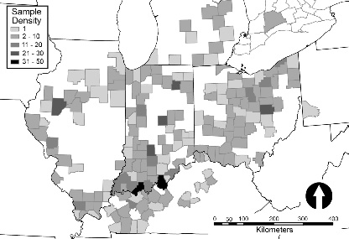
A large undertaking
My dissertation
Rest of the Eastern Woodlands (people other than me, I hope)
South Carolina
Soliciting involvement of professionals and avocationals

Slide 14
Primary data
1) Morphometric data
2) Location
3) Raw materials

Slide 15
1: Morphometry (size/shape)
First, we need to be able to quantify it and understand structure of variability
Then, we can ask a set of questions:
What is stylistic and what is functional?
What changes through time?
How does variability break down according to space?
Archaeological data that can be compared to model results (apples to apples)

Slide 16
2D measurements
Metric data obtained from images of artifacts
Set of replicable landmarks
Applicable to both lanceolate and notched points (mostly)

Slide 17
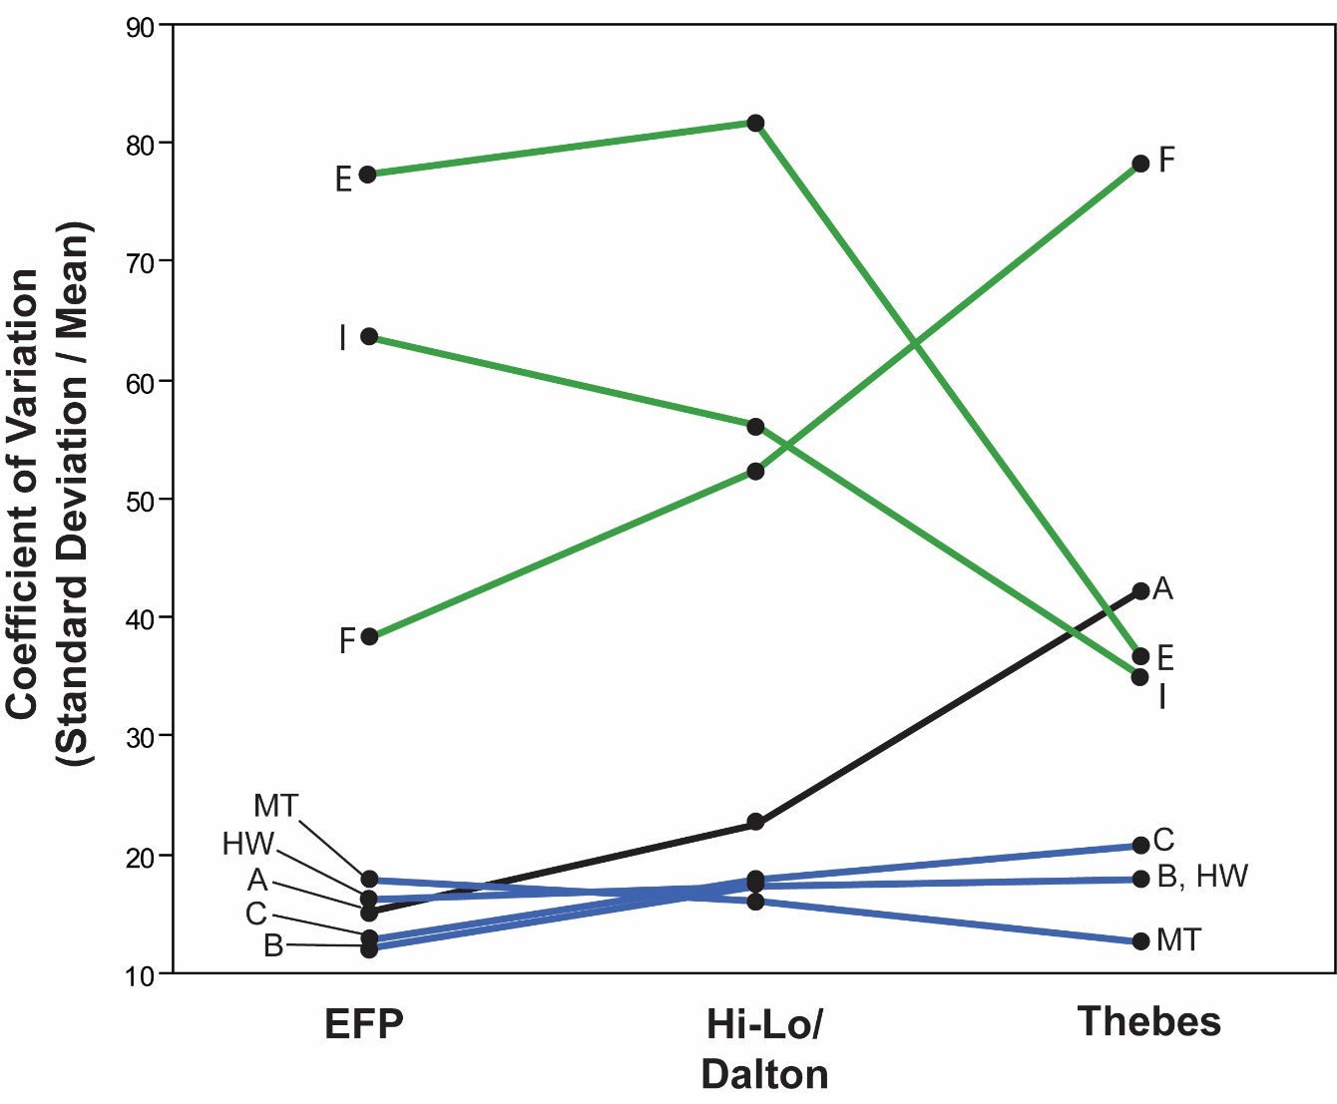
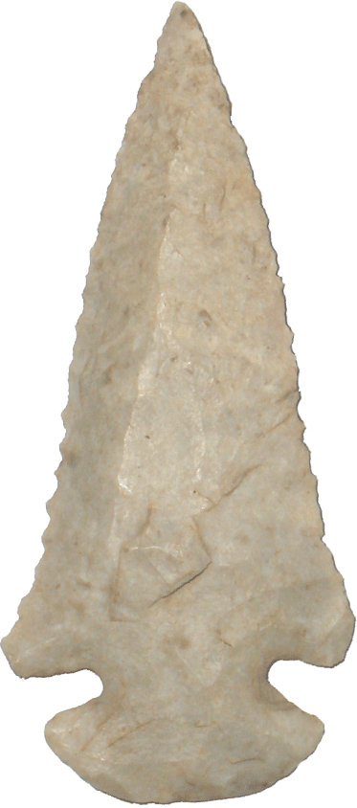
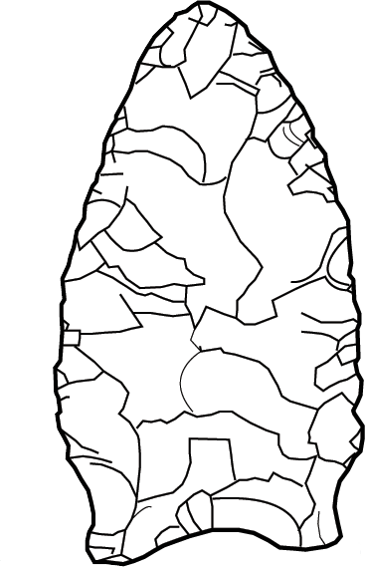
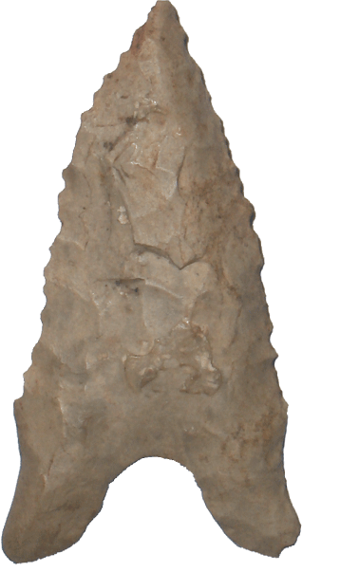
Variability: what’s stylistic and what’s functional?
Constriction
E, F, and I = stylistic:
CV high
Not related to hafting dimensions (not under strong functional selection)
Depth of concavity
“Haft length”
B, C, HW, and MT = functional
CV low
Related to hafting dimensions (under strong functional selection)

Slide 18
3D models
“Virtual” Kirks (print your own!)

Slide 19
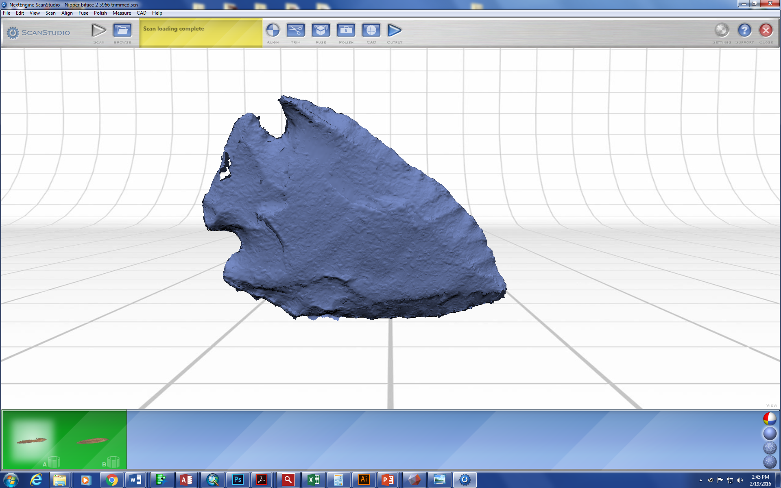
What can 3D models add?
New abilities to extract morphological information that is impossible to get from linear measurements
New ways to investigate size (area, volume)
New headaches

Slide 20
Cross sections

Slide 21
Curvature, contours, splines

Slide 22
Structural weaknesses?

Slide 23
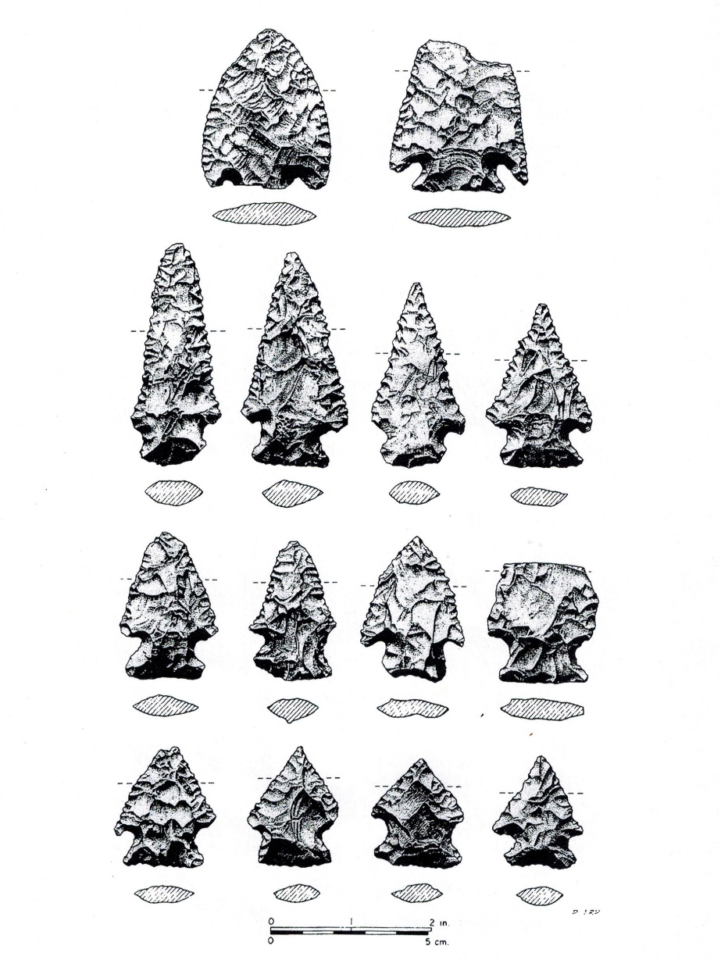
Stylistic variability: what changes through time?
Define characteristics within narrow windows of time using excavated assemblages
Compare variability of whole Kirk dataset to those narrower windows
Nipper Creek cache (38-RD-18)
G.S. Lewis-East (38-AK-158)

Slide 24
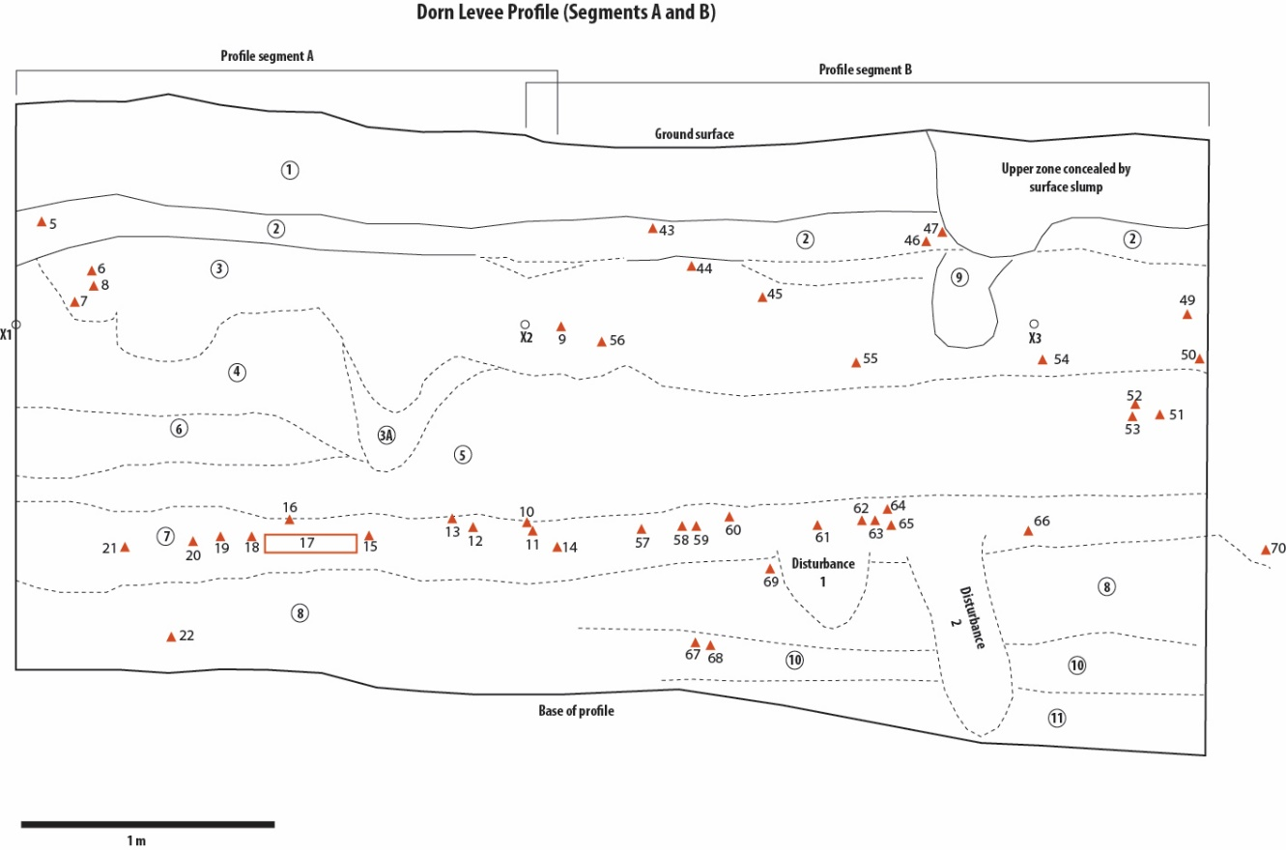
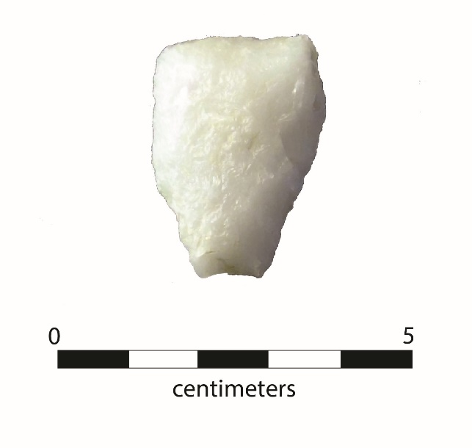
Fingers crossed we can find some more

Slide 25
Stylistic variability: how does it break down in space?
Rasters of Variable EFI (PCA of variables E, F, and I)
Early Paleoindian
Late Paleoindian
Early Archaic
Moran’s I = measure of spatial autocorrelation (GIS)

Slide 27
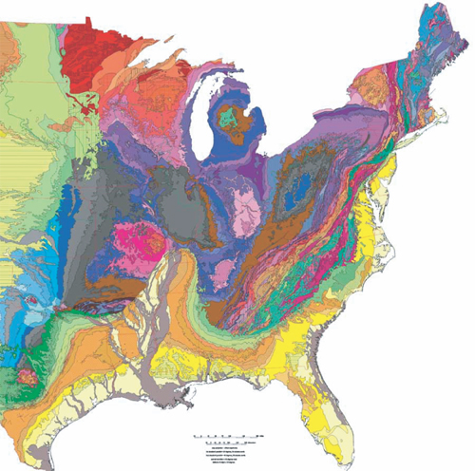
2: Raw Material Transport
Transport of lithic raw materials gives us a behavioral metric that is independent of “style”
Step 1: define scales of transport
Step 2: interpret

Slide 28
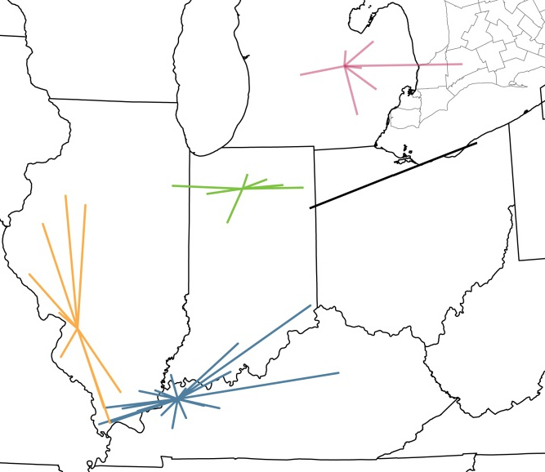
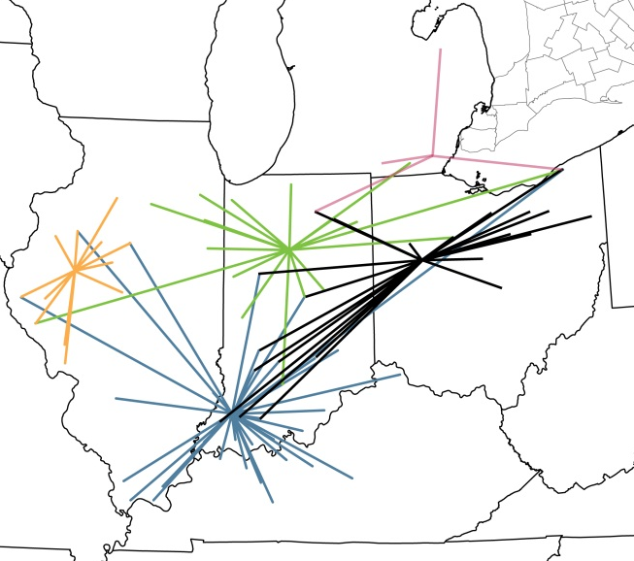
Changing Scales of Raw Material Transport in the Midwest
Early Paleoindian
Late Paleoindian
Early Archaic

Slide 29
Early Archaic Period:
large increase in maximum transport distance
modest increase in mean transport distance
Dalton/
Hi-Lo
EFP
Thebes
Kirk

Slide 30
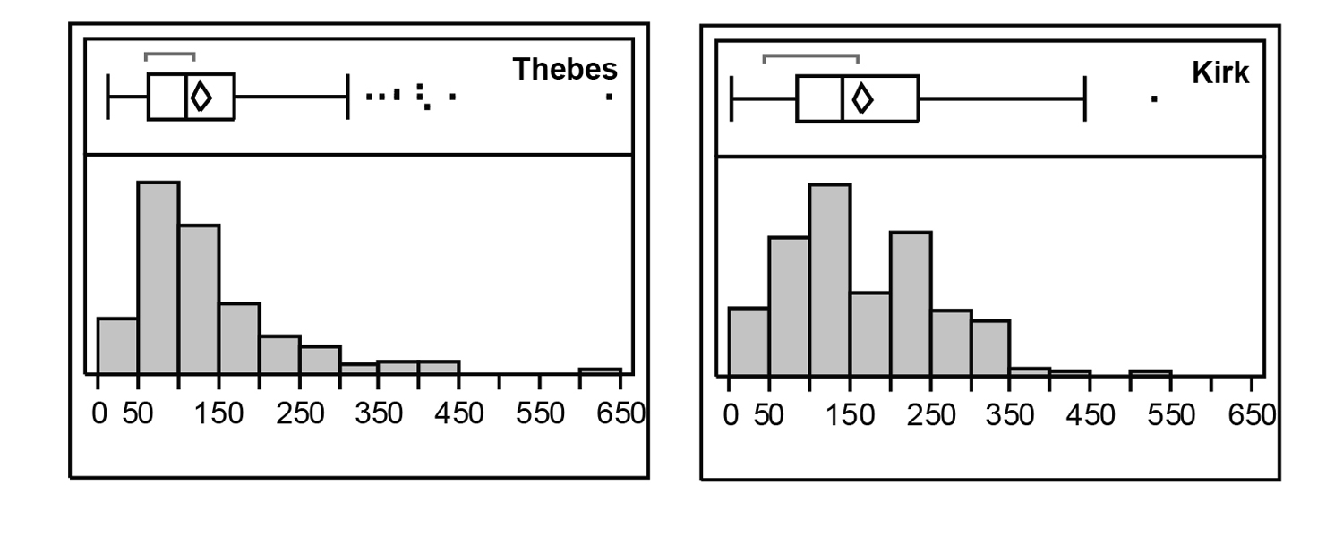
Most points transported < ~ 300 km
Thebes
Kirk
Cantin’s (2000) southern Indiana study produced similar results
300 km “maximum” also consistent with Anderson and Hanson’s (1988) Savannah River study

Slide 31
But how were Early Archaic tools moved across the landscape?
Three non-exclusive possibilities:
Group mobility (artifacts moved as part of normal group movements)
Personal mobility (artifacts move with people from one group to another)
Exchange (artifacts move between people in different groups)
All are ubiquitous among ethnographic hunter-gatherers: there is no reason to assume they weren’t all part of the social systems of early hunter-gatherers in the Eastern Woodlands

Slide 32
Was there exchange during the Early Archaic?
Exchange of artifacts is common among ethnographic hunter-gatherers
Often a mechanism for reinforcing reciprocal relationships when face-to-face interaction is infrequent
Exchange volume is generally low, serving to symbolically maintain social ties rather than move bulk goods
Ahler 1991 (The Living Museum 53(1):3-6)
Marine shell beads from Modoc Rock
Shelter (Randolph County, Illinois)
Tomak 1979 (PIAS 88:62-69)
Marine shell beads from the Jerger
Site (Daviess County, Indiana)

Slide 33
Sparse/absent: Evidence for transport > 300 km of Early Archaic “toolkit” assemblages
Brose 1994; Tankersley and Holland 1994
Deller and Ellis 2010
Ellis et al. 1991
Jackson 1996
Koldehoff and Loebel 2009
Loebel 2005
Simons et al. 1984
Stothers 1996
Wortner and Ellis 1993

Slide 34
Did individuals move between groups during the Early Archaic?
Inter-group movements of individuals are an integral feature of life in all ethnographic, non-sedentary hunter-gather societies
Important mechanism for creating and maintaining social relationships within a spatially-dispersed population

Slide 35
Equifinality problem → modeling opportunity!
No reason to suspect that all of these artifact-transporting behaviors were not present in Early Archaic societies
Change in any could logically cause observed changes in artifact transport pattern
Equifinality problem: different mechanisms, similar outcome

Slide 36
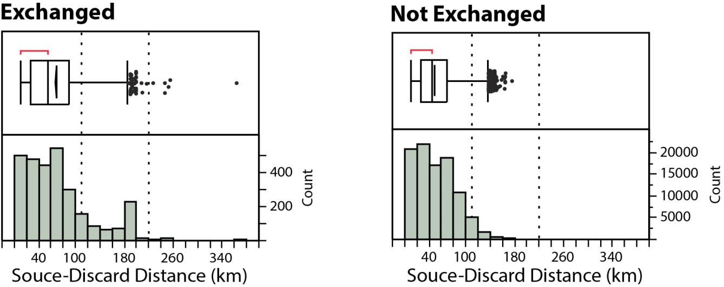
An Example Run: Exp 348, Run 7
Mean distance group movement (110 km)
Max possible distance group movement (220 km)
Distribution of transport distances is composite of many artifacts moved only by mobility and a few artifacts moved by a
combination of mobility and exchange

Slide 37
An Example Run: Exp 348, Run 7
Artifacts that were not exchanged < 180 km from source
All artifacts > 180 km from source were exchanged
Most exchange does not move artifacts long distances from source

Slide 38
In combination with archaeological data, an aggressive model-based approach will, ultimately, be an important part of interpreting the Kirk Horizon

Slide 39
Conclusion
Does the Kirk Horizon mark the re-emergence of a continuous social fabric extending across the Eastern Woodlands?
What is the pattern of the fabric?
How was it woven together? How was it created, and how was it maintained?

Slide 40
Combine point data/interpretation with other lines of evidence
Settlement pattern
Subsistence
Mortuary data
Habitation structures

Slide 41
Hopefully, we’ll be able to answer the question before he’s in his forties

Slide 42
Thank you

